Slide 1






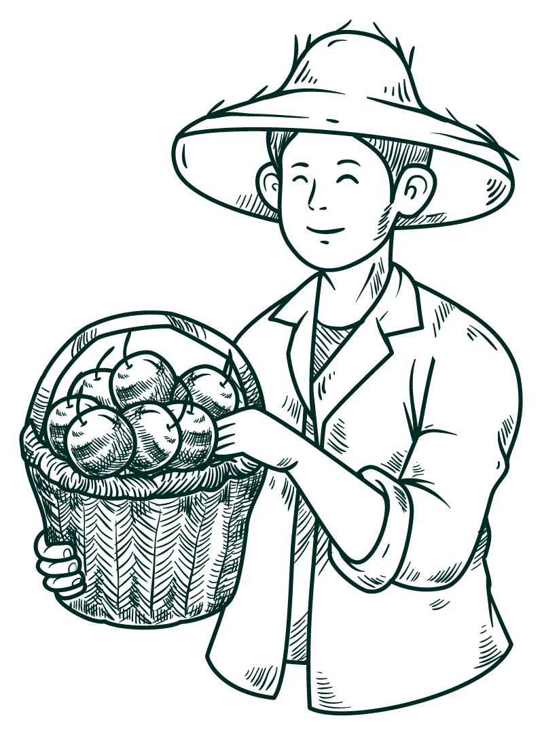


Precision Agriculture – IoT Powered automated irrigation system

Slide 2


TEAM DETAILS
004 – Madras Institute of Technology, Anna University
Team Members
Girish G | 2020506028 | Information Technology
Sandhiya M | 2020506078 | Information Technology
Swetha Das R | 2020506100 | Information Technology
Guided by Dr. M R Sumalatha Professor

Slide 3
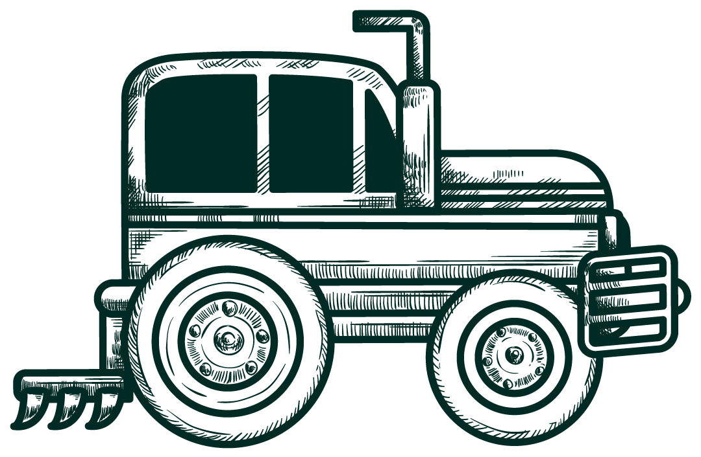
INTRODUCTION
In today's world, where sustainable agriculture is increasingly vital, efficient irrigation practices play a crucial role in optimizing water usage, maximizing crop yields, and ensuring food security.
Traditional irrigation methods often rely on manual intervention or fixed schedules, which can lead to overwatering, water wastage, and suboptimal crop growth.
To address these challenges, we have formulated a mathematical solution that considers water loss from plants due to evapotranspiration, and also uses sensor data which enhances plant irrigation efficiency.
By integrating mathematical algorithm with advanced sensor technologies, our system enables real-time monitoring of soil moisture levels and intelligent decision-making for precise and timely irrigation.

Slide 4
OBJECTIVES
The main objectives of the proposed system are as follows:
To automate the water supply to the crop in order to reduce the human intervention in the irrigation process.
To enable precise irrigation by watering the crops at the time it is needed and at the precise place specifically at the root.
Integrating mathematical derivation to predict the need of water to crops by using real-time weather condition and soil data from sensors.
To fertilize the needed nutrient to the crop in precise amount with help leaf image processing.
Incorporating object detection in quality management of the crops.

Slide 5
LITERATURE SURVEY
S.No | Paper Title | Proposed work | Drawback | Future work
1. | A Self-Supervised Learning-Based Intelligent Greenhouse Orchid Growth Inspection System for Precision Agriculture. (2022) | An orchid growth inspection system is proposed for detecting the growth status of orchids in greenhouses. | Lacks practicality. Scalability issues may occur when implementing this system on a larger scale. | Develop remote monitoring and control capabilities for orchid growers to access real-time data, receive alerts, and adjust greenhouse settings from anywhere.
2. | IoT-based Water Harvesting, Moisture Monitoring, and Crop Monitoring System for Precision Agriculture. (2023) | An IoT-based system is proposed to automate and optimize water harvesting, moisture monitoring, and crop monitoring for precision agriculture. | Lacks predictive capabilities for crop growth rates, potentially limiting farmers' ability to optimize agricultural practices and uneconomical for small-scale farmers. | Use of machine learning algorithms for crop growth rate prediction and the development of low-cost sensors for small-scale farmers.
3. | Smart Irrigation Management System for Precision Agriculture. (2023) | An IoT based smart farming system that helps farmers acquire real time data for effective environmental monitoring that improves overall production and product quality. | Lacks robust security measures and efficient data collection methods thus leading to compromised data integrity and reduced model effectiveness in real-world applications. | The proposed model can be enhanced by taking into account the security aspect and mobile sink.

Slide 6
LITERATURE SURVEY
S.No | Paper Title | Proposed work | Drawback | Future work
4. | Precision Agriculture: Influencing factors and challenges faced by farmers in delta districts of Tamil Nadu. (2023) | A comprehensive study on the demographic factors’ influence on Precision Agriculture, also accesses the influence of Agro ecological factors, behavioural factors, institutional factors, informational factors, technical factors, perception factors towards Precision Agriculture adoption. | Limited only to the delta districts of Tamil Nadu and concentrates only on the attributes and challenges faced by farmers in adopting Precision Agriculture. | Expand this study to a wider geographic area and explore additional factors that impact the adoption of Precision Agriculture.
5. | Towards a Multimodal System for Precision Agriculture using IoT and Machine Learning. (2021) | A system that incorporates all common state-of-the-art approaches for precision agriculture use. Technologies like the Internet of Things (IoT) for data collection, machine Learning for crop damage prediction, and deep learning for crop disease detection are incorporated. | The model's limited ability to produce high-quality results for minority classes, compounded by the lack of hyperparameter optimization. | Developing models that are better suited to handle imbalanced datasets, improving minority class representation, and introducing hyperparameter optimization techniques to enhance model performance.
6. | Precision Agriculture: IoT Based System for Real Time Monitoring of Paddy Growth. (2023) | An IoT-based system for tracking paddy growth, made up of numerous sensors that gather information about the environment in real-time, including temperature, humidity, soil moisture, and water levels. | Potential cost and scalability challenges, ongoing maintenance and reliability concerns. | Integrating AI and ML for more efficient data analysis, enabling remote monitoring and control, enhancing usability and accessibility.

Slide 7
METHODOLOGY
Sensor Network - Building a sensor network with various sensors such as soil moisture sensor, temperature and humidity sensor to collect the real-time soil condition.
Data Collection - The data is collected from the soil and the target value i.e., to turn on or off the water pump is created such that it could be used to train the AI model.
Mathematical Formulation for Irrigation- An mathematical formula is built with FAO reference created to predict the target action. The real-time weather is also used in decision making to minimize the water usage.
Fertigation - Image based nutrient deficient identification system is incorporated to fertigate the crops in precise manner.
Quality Management - The crop quality management is integrated to ensure providing the timely indication of harvesting and loading to market.
Remote Control - Enabling remote control of irrigation through mobile application.

Slide 8
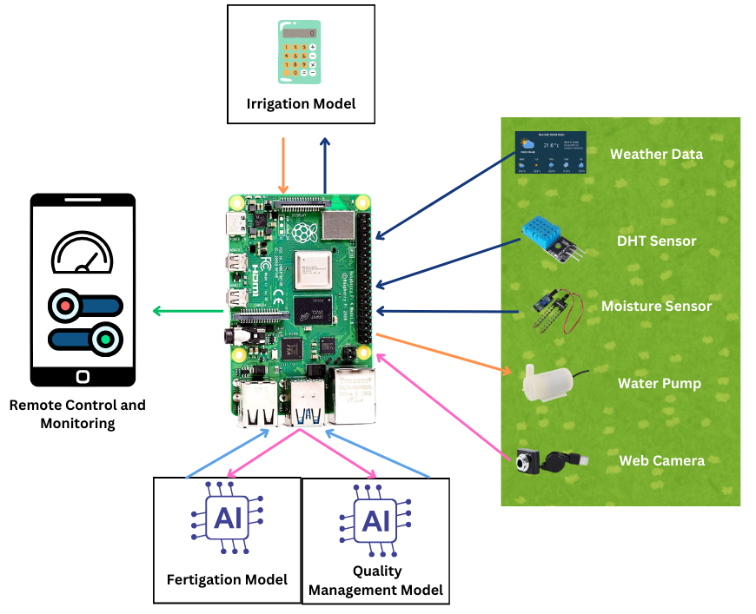
Modular ARCHITECTURE

Slide 9
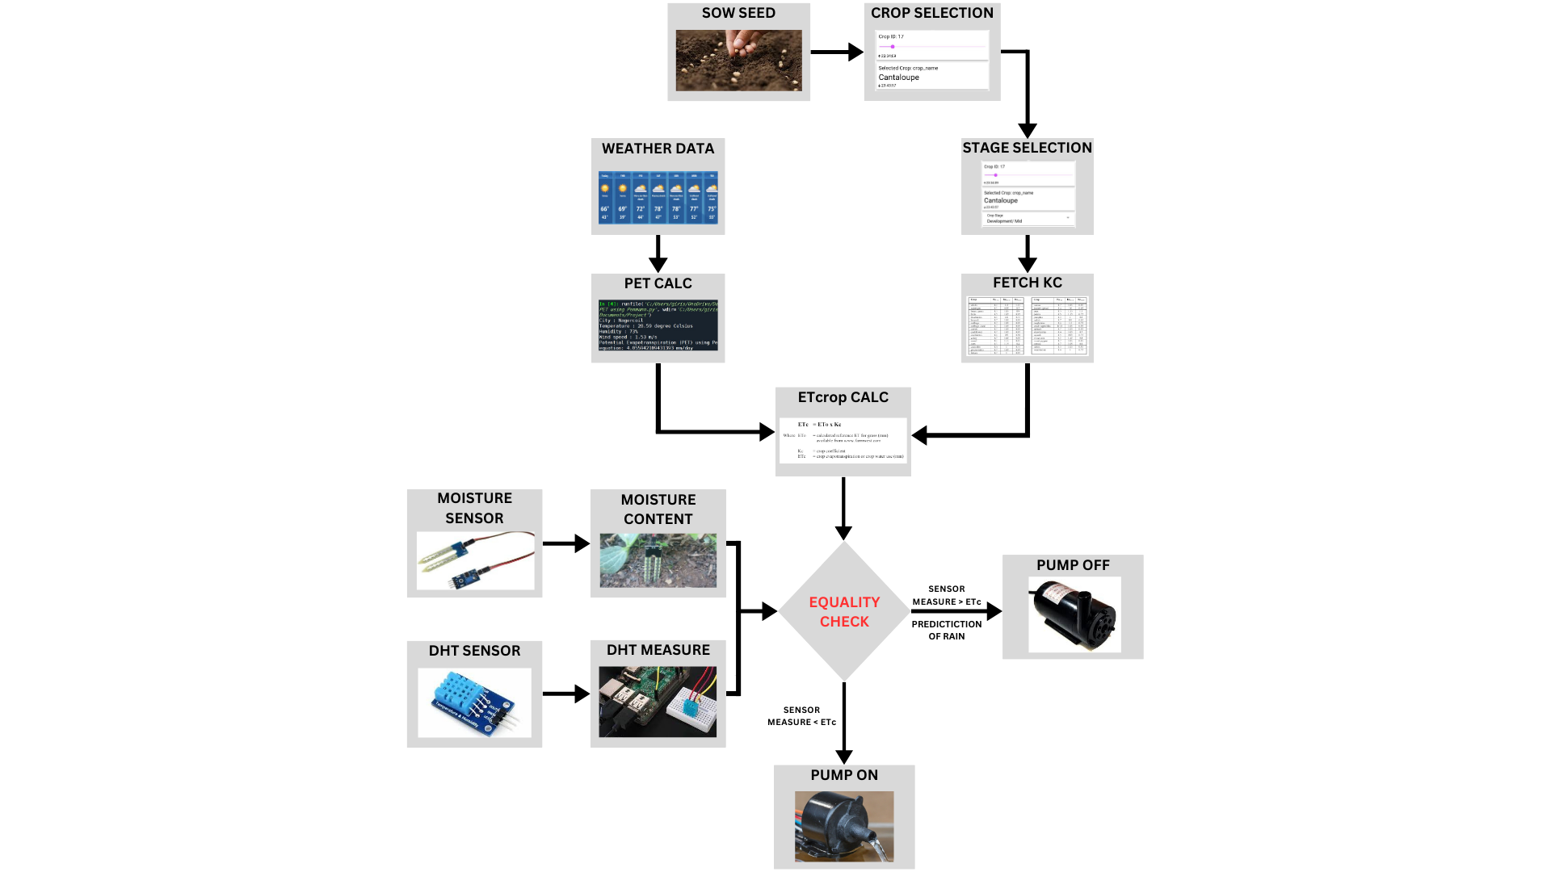
IPAIS – ARCHITECTURE for Irrigation

Slide 10
Hardware Requirements
Raspberry pi
Soil MOIsture sensor
Temperature sensor
Humidity sensor
Water pump
Web camera
Connecting wires
Buzzer

Slide 11
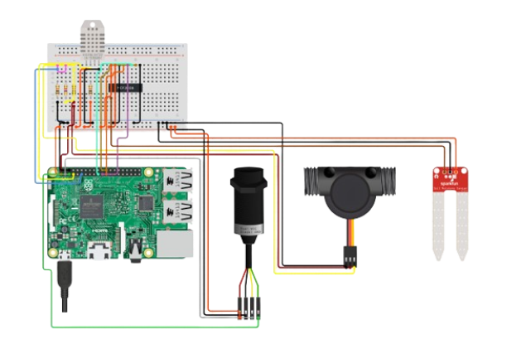
SENSOR NETWORK – Circuit diagram

Slide 12
SENSOR NETWORK – Threshold matching
Define optimal moisture thresholds for the crop considering factors like soil moisture, temperature, humidity and other environmental conditions.
Calibrate soil moisture sensors for accurate readings aligned with thresholds, ensuring precision in moisture measurement for effective watering control.
Calculate the appropriate water need of the selected crop.
Continuously collect soil moisture data using sensors and monitor real-time moisture levels in the soil.
Compare actual moisture data with calculated thresholds and trigger watering when moisture levels are not upto threshold and expected weather to be dry.
When actual moisture goes low and expected weather to be wet no triggering of water pump.

Slide 13
Efficiency of irrigation systems
Surface Irrigation (45%)
Sprinkler Irrigation (75%)
Localized Irrigation (90%)

Slide 14
Algorithm for calculating water need by a crop (ETc)
Calculate Reference ETo (Use FAO Penman-Monteith method)
Select stage lengths
Kc Single crop coefficient
Select values for Kc ini, Kc mid & Kc end
ETc = ETo x Kc
1
2
3
4
5

Slide 15



determination OF CROP EVAPOTRANSIPRATION(ETc)
The Crop water need(ETc) is the amount of water needed by a certain crop to grow optimally. It can be calculated as the product of Kc and ET0.
Where,
Kc Crop Factor
ET0 Reference crop evapotranspiration
Unit: mm/day
ETo × Kc = ET crop
For calculating ETo, we need the following:
+
Climate data
Reference crop (Grass)
ET0
(mm/day)

Slide 16
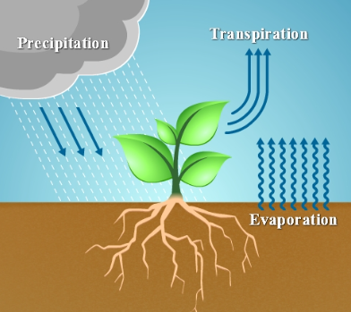
Calculation of ET0 using Penman-Monteith equation
Formula:
PET = (0.408 * ∆ * (Rn - G) + γ * (900 / (T + 273)) * U * (e_s - e_a)) / (∆ + γ * (1 + 0.34 * U))
Where,
PET = Potential Evapotranspiration (mm/day)
∆ = Slope of the vapor pressure curve (kPa/°C)
Rn = Net radiation at the crop surface (MJ/m²/day)
G = Soil heat flux density (MJ/m²/day)
γ = Psychrometric constant (kPa/°C)
T = Mean daily air temperature at 2 meters height (°C)
U = Wind speed at 2 meters height (m/s)
e_s = Saturation vapor pressure (kPa)
e_a = Actual vapor pressure (kPa)

Slide 17



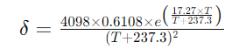
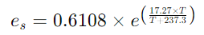
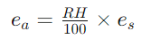
Fetching weather data
API
Temperature(T)
Wind speed(U)
Relative humidity(RH)
Atmospheric Pressure
Latitude & Longitude
Magnus Formula to find slope of vapor pressure curve(δ) and saturation vapor pressure(e_s):
Actual vapor pressure(e_a) represents the vapor pressure of water vapor in the air.
Estimations:
Net radiation(Rn) = 10 MJ/m²/day
Soil Heat Flux Density(G) = 0.1 MJ/m²/day

Slide 18

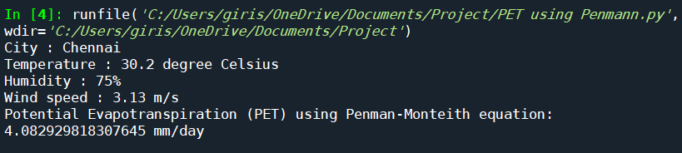
PET Calculation
Latitude, Longitude
Fetch Weather data
Calculated PET ET0(Reference crop Evapotranspiration)
ET0 × Kc = ET crop
ET0 × Kc = Irrigation Water Need in mm/day (ETc)

Slide 19
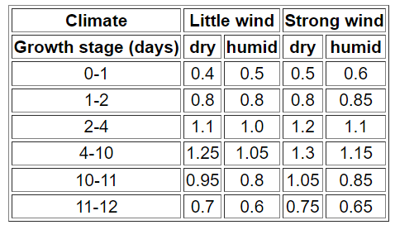
Crop factor (Kc)
ET0 × Kc = ET crop
The crop factor, Kc, mainly depends on:
Type of crop:
For crops with large leaves, water loss through transpiration will be more and crop water requirement will be more. Hence the value of Kc will be greater than 1 (Kc > 1).
Growth stage of the crop:
A certain crop will use more water once it is fully developed, compared to a crop which has just recently been planted.
Climate:
The climate influences the duration of the total growing period and
the various growth stages. In a cool climate a certain crop will grow
slower than in a warm climate. In particular, on the relative humidity and
the windspeed. The values indicated above should be reduced by 0.05
if the relative humidity is high (RH > 80%) and the windspeed
is low (u < 2 m/sec)
Kc values for Virgin Sugarcane

Slide 20
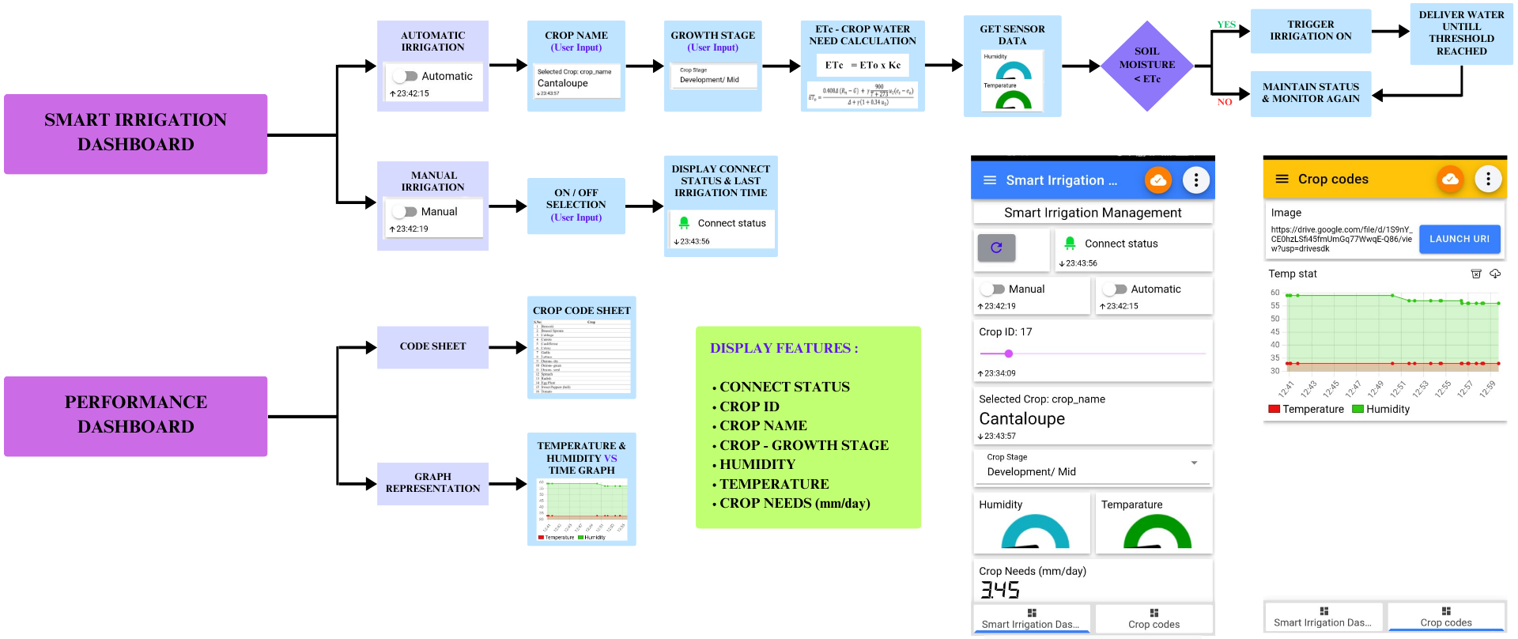
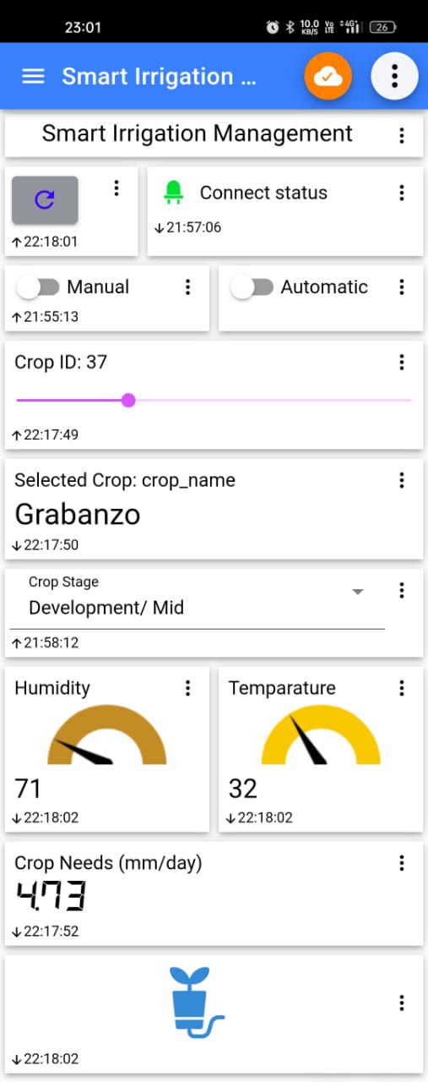
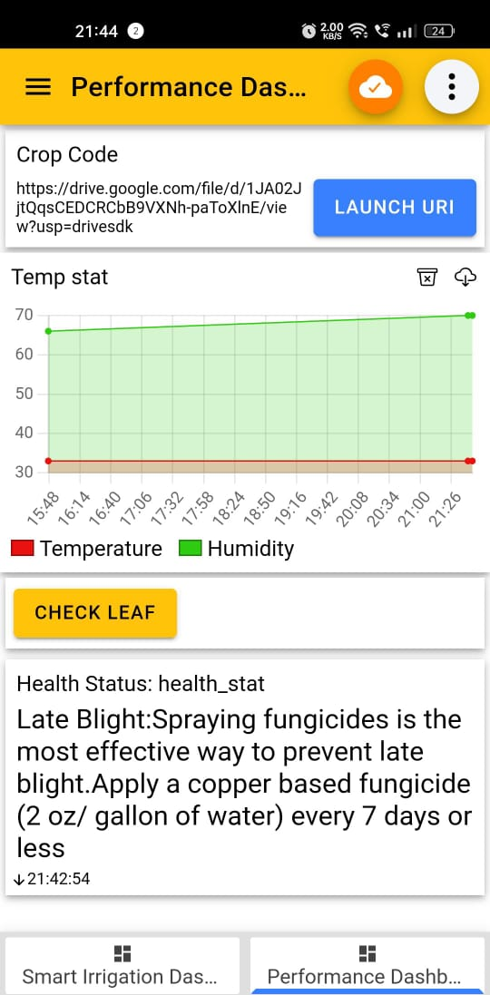
APPLICATION FLOW – SMART IRRIGATION MANAGEMENT

Slide 21
Irrigation SETUP
Flower Beds
Flowers can benefit from a micro irrigation system that provides water only to the plants that need it.
Vegetable Gardens
In rows or patches, vegetable plants can get all the water they need while decreasing the likelihood of weed growth and reducing pesticide use.
Trees and Shrubs
Whether circling a tree or running along shrubbery, micro irrigation can keep the roots moist without wasting water where it’s not needed.
Container Plants
Micro irrigation works for potted plants too. On balconies, porches, or decks, plants in containers can benefit from water lines that deliver water right to the roots.

Slide 22
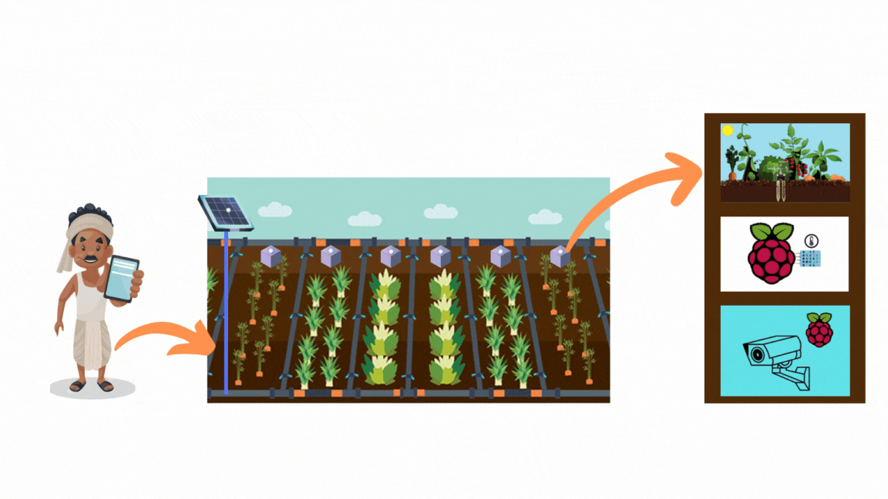
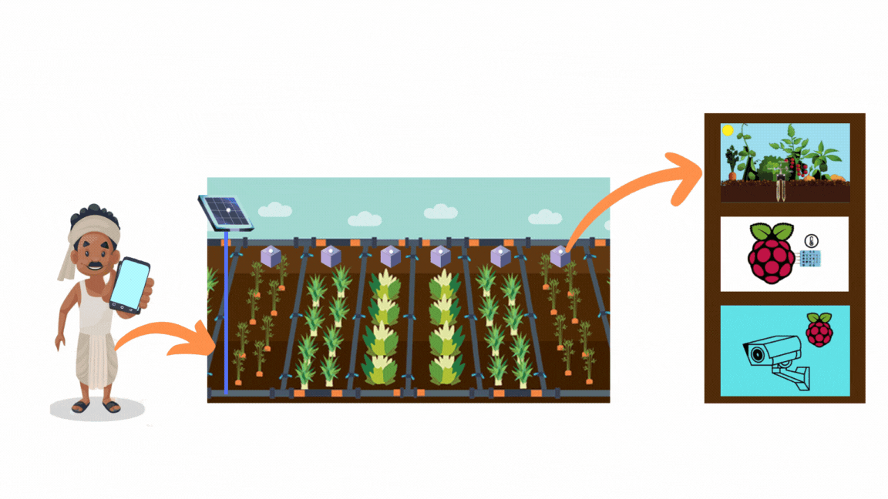
BIG PICTURE OF THE SYSTEM

Slide 23



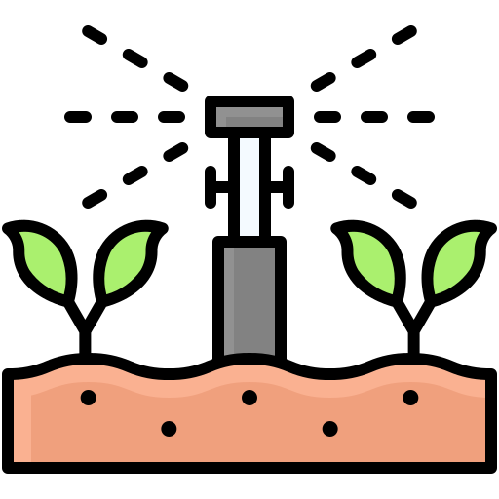


TIMELINE
PHASE 1
PHASE 2
PHASE 3
PHASE 4
CNN Model Development
System setup and sensor integration
Irrigation Automation
Application Development and Integration

Slide 24
Team CONTRIBUTION
Sandhiya M (2020506078) | Girish G (2020506028) | Swetha Das R (2020506100)
Fertigation Model
Data Synthesis with SMOTE. Data Synthesis with ADASYN. Custom CNN model building for image classification. | Custom CNN model building for image classification Parameter tuning of trained models. | Data collection and cleaning Data Augmentation with web scraping.
Irrigation Model
Integration of codes to obtain the water need. | Development of code snippet for Penman-Monteith equation. Development of code for weather data collection. | Preprocessed the crop specific constant value.
Hardware Organization
RPi initialization with Raspbian OS. Connected all the sensors, camera and built a sensor network with RPi. | Resolved dependency errors in Python. | Built a prototype of the model with Arduino.

Slide 25
Team CONTRIBUTION
Sandhiya M (2020506078) | Girish G (2020506028) | Swetha Das R (2020506100)
Application Development
Development python script to use MQTT protocol to integrate the RPi and mobile application.

Slide 26
Conference and Journals
We have submitted our PHASE – I work “Self- Serviced Medical Community with Blockchain for Ocular Disease” to 5th International Conference on Data Science and Applications (ICDSA 2024).
Working on the current work PHASE – II to be submitted in a Upcoming Journal (IJERT 2024).

Slide 27
THANK YOU

